Slide 1
August 2014
Apigee Certification Deep Dive
DevOps Tools for the API Lifecycle

Slide 2
Agenda
API Lifecycle
How did we get here?
What is it all about?
Why is this important?
Section 1: The Zen of Source Code Management
Which branching strategy is more suitable for my API?
Getting Started: Applying branching strategy concepts
Section 2: The Zen of Build Management
Selecting the right build tool:
deploy.py / deploy.sh – Management API
Apigee Deploy Maven Plugin
Grunt API Lifecycle Management Plugin
Getting Started: Setting up and running the tools
Notes:
So, what are going to talk about today?
How did we get here?
We’re going to provide a little bit of context around phases of the build process
Specifically, how build can quickly spin out of control and some of the techniques that developer teams can use to mitigate risks of build hell
realize the importance of the life cycle, so you can continuously improve it, by eliminating waste (gaining 5% of efficiency)
Section 1:
So, in section #2 we’ll try to address the challenges by providing you with the tools to manage the lifecycle
So, we’ll cover from basic to more advanced tools and techniques
And explaining their differences
Section 2:
We will cover complementary tools that address other phases of the lifecycle
Take it to the next level:
- I'm going to try to bring most of the techniques talk how to bring everything home
Functional Testing:
- Tools that you have a available for functional testing

Slide 3
Agenda
Section 3: Keep the momentum up - Build Complementary Tools
Code reusability – Proxy Maven Dependency Plugin
Testing APIs
Section 4: Make it eternal, take it to the next level
Continuous Integration/Delivery
Where everything comes together Jenkins / Maven / Grunt / JMeter
Getting Started: Setting up Jenkins Jobs
Section 5: Make it stick
API Doc Tools:
SmartDocs
APIBlueprint.org
Notes:
So, what are going to talk about today?
How did we get here?
We’re going to provide a little bit of context around phases of the build process
Specifically, how build can quickly spin out of control and some of the techniques that developer teams can use to mitigate risks of build hell
realize the importance of the life cycle, so you can continuously improve it, by eliminating waste (gaining 5% of efficiency)
Section 1:
So, in section #2 we’ll try to address the challenges by providing you with the tools to manage the lifecycle
So, we’ll cover from basic to more advanced tools and techniques
And explaining their differences
Section 2:
We will cover complementary tools that address other phases of the lifecycle
Take it to the next level:
- I'm going to try to bring most of the techniques talk how to bring everything home
Functional Testing:
- Tools that you have a available for functional testing

Slide 4
API Lifecycle
Notes:
DIEGO –
So, before diving deeper into technical aspects, let’s talk a little bit about the current state of the build and deployment process

Slide 5

API Lifecycle
Let’s take a look at the tasks required
Package phase
Clean API Bundle Files and Folders
Copy Artifacts
Configure phase
Configure Artifacts for each environment (DEV, QA, STG, PROD, etc.)
Package Artifacts (zip)
Install phase
Deactivate last revision from the API Services
Import and deploy API bundle to API Services
Execute Unit Tests
Execute Functional Tests
There must be a way to automate all this tedious work!
Execute Performance Tests
Deploy and Test Documentation on CMS
Any other manual tasks…
Notes:
DIEGO
This is assuming developers work on file-based development: UI Development does some of these tasks through the browser
Before code gets shipped to an environment be it Development, QA, staging, or production, it needs to go through a build process which executes the following task
Some of these tasks aren’t required or could be executed in a different sequence
Too many steps to go through and each one of them is essential
Depending on the task, between 38 per cent and 59 per cent of users were still carrying them out manually
We (software engineers) do a great work at automating the work for others, but about ourselves

Slide 6
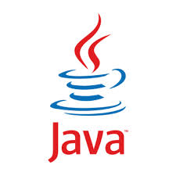





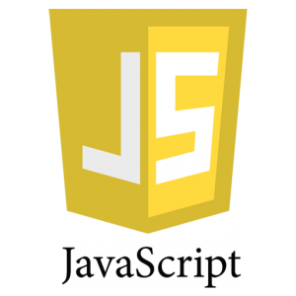



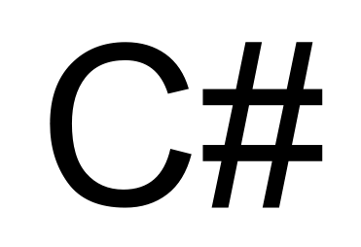

API Lifecycle
Without the right tools, API build can be really painful
Automate with in-house tools!
Notes:
As a resourceful developer what would be my first instinct
We (software engineers) love solving problems
However, sometimes building solutions in-house can become hard to maintain
Everyone has a different approach to solve issues “if all you have is a hammer, everything looks like a nail ...”
We know the story
That’s great!

Slide 7
In-house tools solutions don’t come for free…
API Lifecycle
Someone needs to maintain them. There’s no open source community around them
Good for specific purposes. But what about integrating them with my Continuous Integration/Delivery (CI/CD) Systems?
Some languages are platform specific. Vendor locking
Notes:
From my experience and I am sure we have all have seen it. In house solutions don’t come for free…
Someone needs to maintain them
Let’s face it. No body writes perfect code the first time. Our tools may and will fail. So, they need also need to go through QA, right?
So, for instance, what would happen when one of the scripts who was written by of the developers is no longer in my team?
What about bugs?
Can they improve and evolve independently without coming major cycles from my API development team? My api team needs to focus on the api
Are they extensible enough?
However, we still need flexibility to extend the standard process. To customize the build process rather to reinventing the wheel
Can they be orchestrated with other without major rework?
How can I prevent vendor locking
After gaining speed with the process, you also want to automate deployment to go even faster.

Slide 8
Summary
Identify main drivers to automate the API lifecycle
Identify common tasks/phases of the API Lifecycle
Realize of more possibilities to introduce efficiencies by continue improving the API Lifecycle
Notes:
First-Time setup and get to the source
You had your first encounter with the Apigee Plugin by first setting up your environment and cloning the github repo
As we tested there were zero dependencies with private repos
Start with the right API structure
To identify the key elements of the API bundle and where they reside in the folder structure
So, you can follow best practices by defining the API structure from the get go. Since you’re going to use continually use this structure for multiple APIs, eventually you’ll implement more API bundles and troubleshoot them, so it highly recommended to become intimately familiar with it.
Introduced share-pom.xml to provide an example of aggregation in terms configuration, by declaring common configuration in a single place
We also introduced API pom.xml
Apply inheritance
To avoid duplication and better maintainability

Slide 9
The Zen of Source Code Management

Slide 10
The Zen of SCM
Define your branching and merging strategy from the get go
Opt for a scalable model
Single Repo vs. Multiple Repos
Communicate and provide feedback through pull requests (aka. social coding)
Apply CI and avoid big bang merges
Practice, practice, practice

Slide 11
The Zen of SCM
What can be managed in SCM?
API Artifacts
API proxy source code (XML, JS, Java, Python, binaries, etc.)
API Documentation (Markdown, HTML,
Testing Artifacts
Scripts
Data
Configuration, Deployment and management scripts
Management API requests to create entities like target servers and data stores
Configuration Data
Keep sensitive data out of SCM

Slide 12
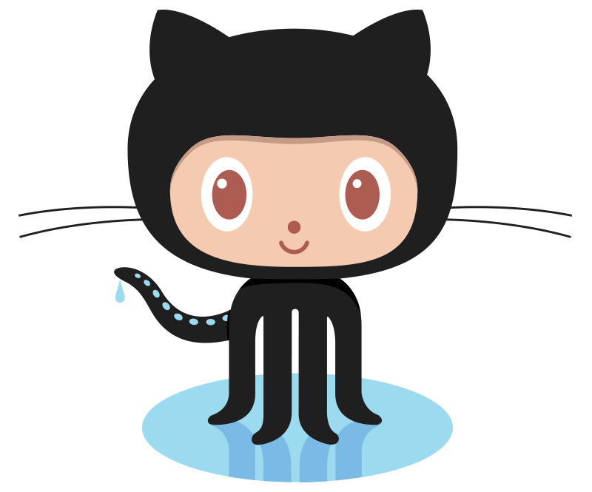
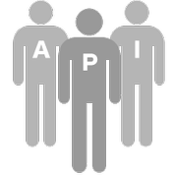

Source code management: “Fork-and-pull” model
Fork repository
Issue pull request
1
Deploy to test
Deploy to production
Clone to workstation
Commit to clone repository
5
2
4
Committers
7
8
6
Deploy and test
Development Environment
Testing Environment
Production Environment
3
Developer Workstation

Slide 13
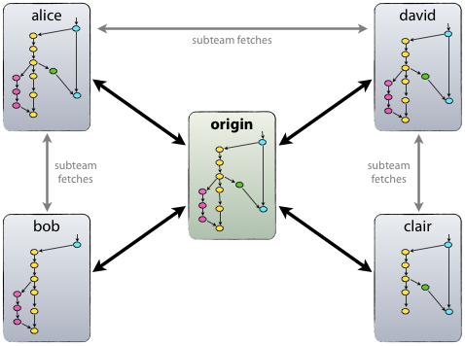
“Fork and clone”
Decentralized but centralized
Centralized repository is “forked” by all developers, enabling them to perform completely independent development
Not always required
Ideal for open source projects
API Teams can clone repo only
Source: http://nvie.com/posts/a-successful-git-branching-model/

Slide 14
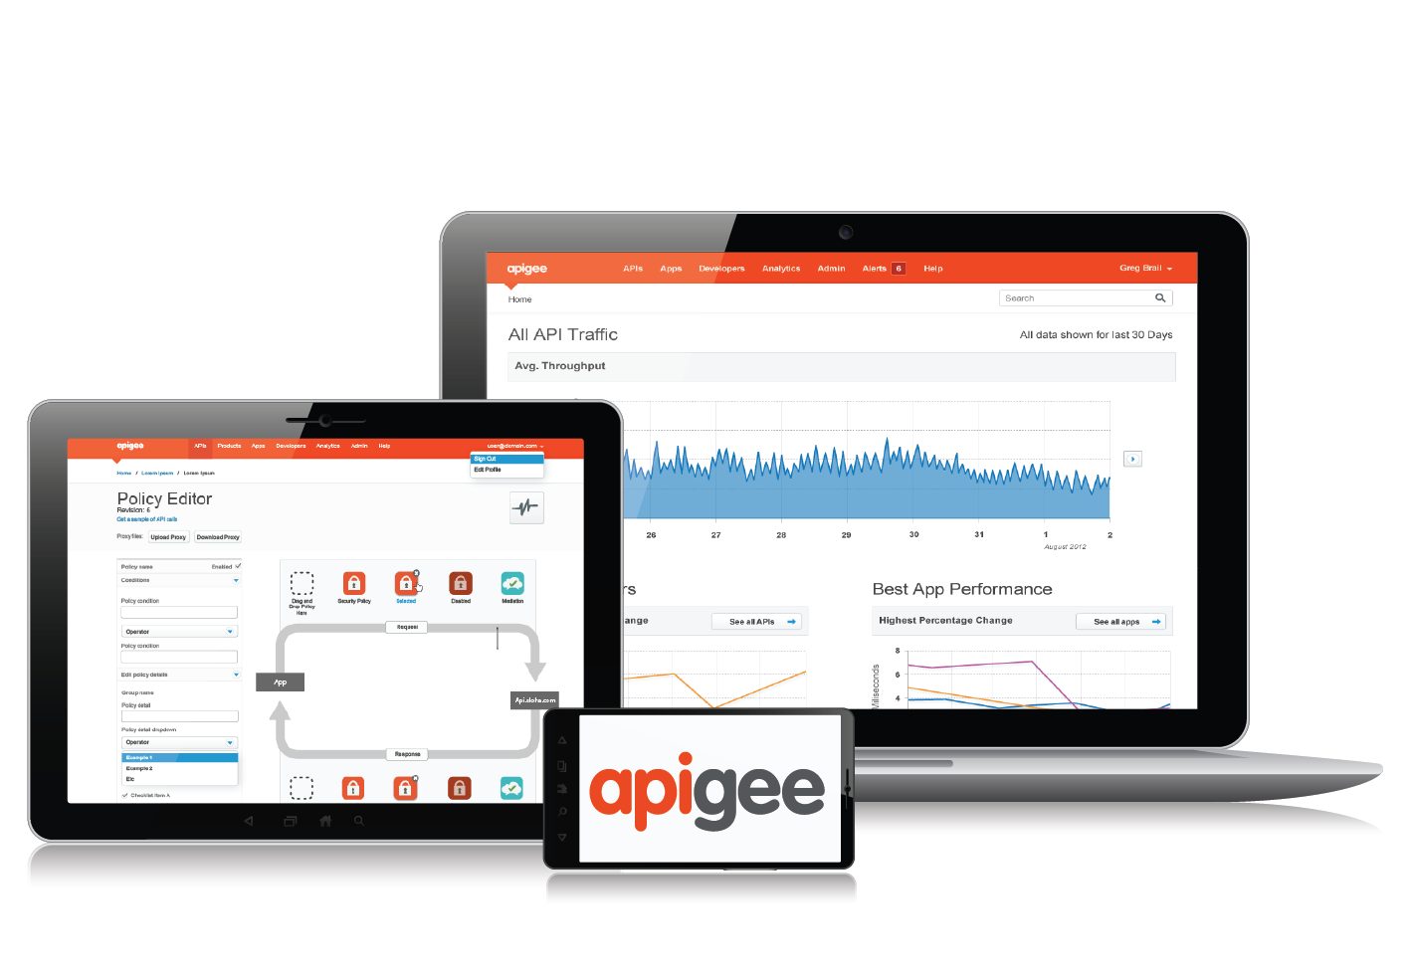

Source code management: Shared repository model
Develop using UI
API Team
Configure/Import
Export to SCM via Apigee API
1
2
3
Confgure/Import
4
Development Environment
Testing Environment
Production Environment

Slide 15
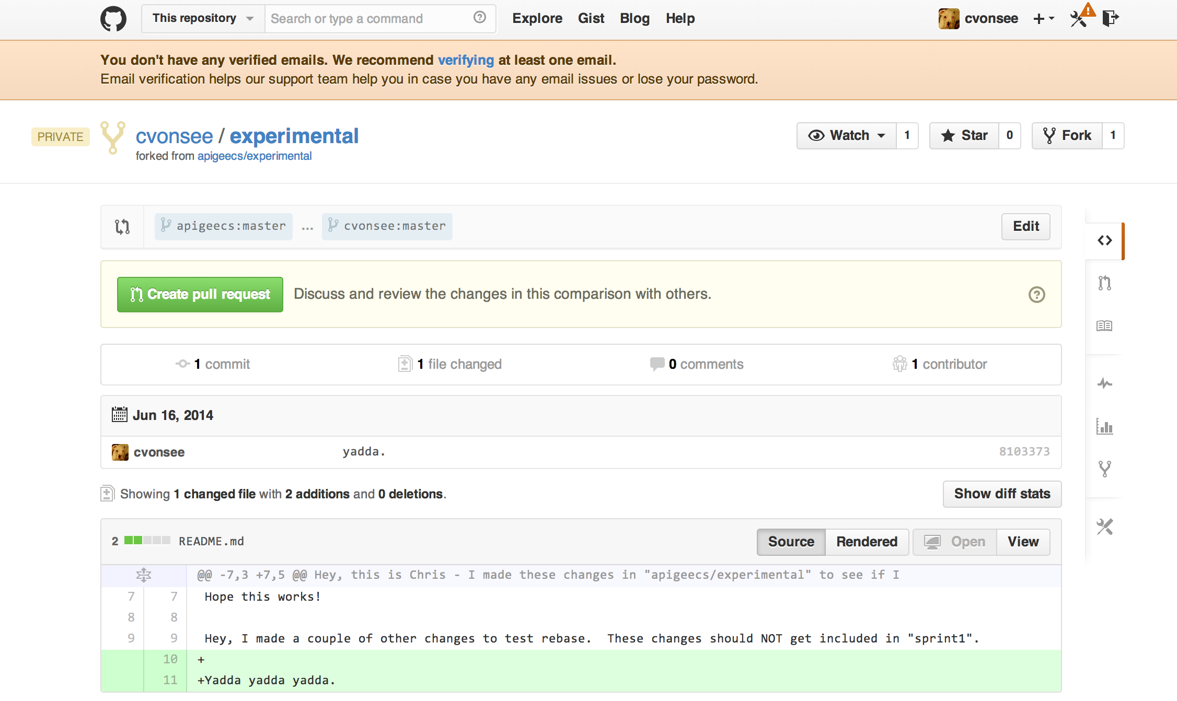
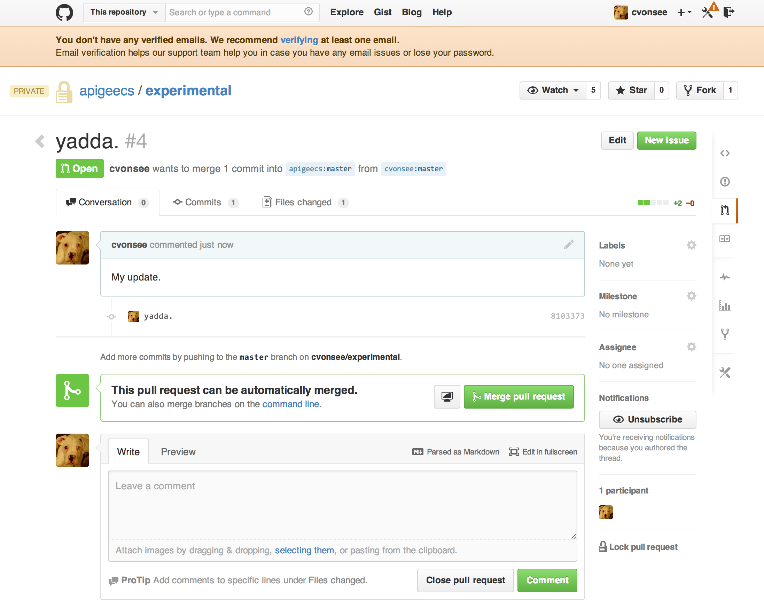
Using pull requests

Slide 16
The Zen of SCM: Take Action
Steps
Fork https://github.com/dzuluagacert/apigee-tutorials
Clone it locally
Modify a file, commit, and send a pull request
Optional
Configure remote fork https://help.github.com/articles/configuring-a-remote-for-a-fork
Sync up with remote repo https://help.github.com/articles/syncing-a-fork
Notes:
Demo with no skipTests arguments
Notice passing username and password as environment variables. You don’t want to expose your credentials storing them in you source control repository
Notice I passed –Dorg=testmyapi, in case you want to target an organization different than the default one specified in pom.xml
Config.json to be explained in the next steps
Tests with Jmeter to be explained in the next steps

Slide 17
The Zen of SCM
Monolithic API Branching and Merging model
Single master branch
Single develop branch for all APIs
All feature branches merge into develop
Multiple master branches
API-Centric Branching and merging model (single repo)
One branch per API
Merges to its own branch

Slide 18
The Zen of SCM
API-Centric Branching and merging model in multiple repos
Common Code using Submodules

Slide 19
The Zen of SCM
Give and Takes
Easy to get started
No brainer for merges
OK for small API teams
More difficult to track changes
Less adaptable for DevOps
More difficult of releasing and versioning
More difficult for CI
Not team scalable
Plays well with CI
Plays well with DevOps
Each API is considered an independent single development/deployable/testable unit
APIs are versioned and released independently
Promotes separation of concerns (separate ownership)
It scales
Requires more upfront planning

Slide 20
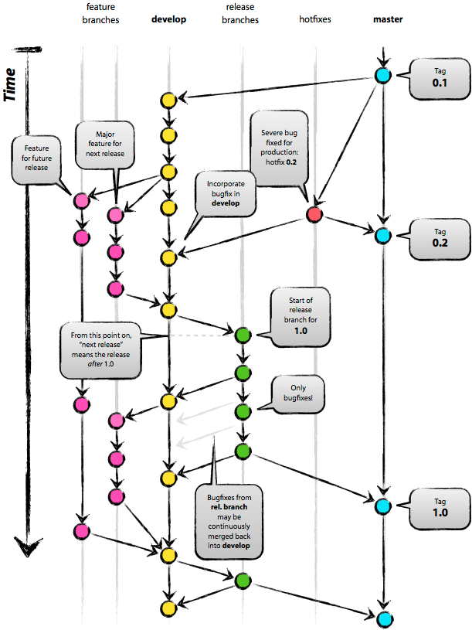
The open-source / Apigee branching strategy
The Zen of SCM
develop branch
develop- forecastweather-v1
master branch
forecastweather-v1
Centralized repository per API
Branches used for management of projects, features and fixes
“master” forecastweather-v1
“develop” develop-forecastweather-v1
“feature” WC-001, WC-002, WC-003
“release” release-forecastweather-v1.3.0 (Semantic Versioning)
“hotfix”
hotfix-forecastweather-1.0.1
Source: http://nvie.com/posts/a-successful-git-branching-model/

Slide 21
The Zen of SCM
Separate Repos per API vs Single Repo for all APIs
Naming conventions
Branch Type | Multiple Repos (one per API) | Single Repo for all APIs
Master | master | {apiname}
Develop | develop | develop-{apiname}
Release | release-{release} | release-{apiname}-v1.3.0
Hotfix | hotfix-{release} | hotfix-{apiname}-v1.3.1

Slide 22
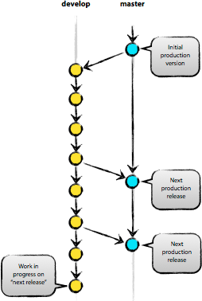
About “master” and “develop” branches
The Zen of SCM
develop-
forecastweather-v1
master
forecastweather-v1
“Master” branch contains the currently-deployed code in production
“Develop” branch represents code for a current development project
“Develop” branch also represents continuous integration
Source: http://nvie.com/posts/a-successful-git-branching-model/

Slide 23
The Zen of SCM: Take Action
Steps
Use https://github.com/dzuluagacert/apigee-tutorials
How to create a master orphan branch? (optional)
git checkout --orphan forecastweather-v1 git rm -rf .
How to create a develop branch?
git checkout –b develop
Merge to master
git merge --no-ff develop
Notes:
Demo with no skipTests arguments
Notice passing username and password as environment variables. You don’t want to expose your credentials storing them in you source control repository
Notice I passed –Dorg=testmyapi, in case you want to target an organization different than the default one specified in pom.xml
Config.json to be explained in the next steps
Tests with Jmeter to be explained in the next steps

Slide 24
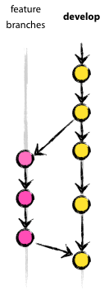
About “feature” branches
The Zen of SCM
Feature branches:
WC-100
Develop branches:
develop-
forecastweather-v1
“Feature” branches (aka “topic” branches) are used for development of a specific feature
Feature branches are merged into a development release when work on the feature is complete
Source: http://nvie.com/posts/a-successful-git-branching-model/

Slide 25
The Zen of SCM: Take Action
Steps
Use https://github.com/dzuluagacert/apigee-tutorials
Checkout develop branch
git checkout develop
How to create a feature branch?
git checkout -b WC-{story_id}
How to merge to a feature branch?
git merge --no-ff WC-100
Notes:
Demo with no skipTests arguments
Notice passing username and password as environment variables. You don’t want to expose your credentials storing them in you source control repository
Notice I passed –Dorg=testmyapi, in case you want to target an organization different than the default one specified in pom.xml
Config.json to be explained in the next steps
Tests with Jmeter to be explained in the next steps

Slide 26
Important Concepts
Fetch the latest changes on develop branch
git fetch origin develop
Rebase feature branch to latest develop branch
git rebase develop
Update feature branch in origin
git push origin WC-101
Clean up feature branches
git branch -d WC-101
Delete feature branch from origin
git push origin :WC-101
Notes:
Demo with no skipTests arguments
Notice passing username and password as environment variables. You don’t want to expose your credentials storing them in you source control repository
Notice I passed –Dorg=testmyapi, in case you want to target an organization different than the default one specified in pom.xml
Config.json to be explained in the next steps
Tests with Jmeter to be explained in the next steps

Slide 27
About “release” branches
The Zen of SCM
“Release” branches are created when code from “develop” is almost ready to be deployed to production
Only very minor changes are allowed to release branches, and these must be merged back into the develop branch.
How to create a release branch?
git checkout -b release-1.2 develop
./bump-version.sh 1.2 -> update a file
git commit -a -m "Bumped version number to 1.2"
Then tag and finish a release branch
git checkout master
git merge --no-ff release-1.2
git tag -a 1.2
git branch -d release-1.2
git push --tags

Slide 28
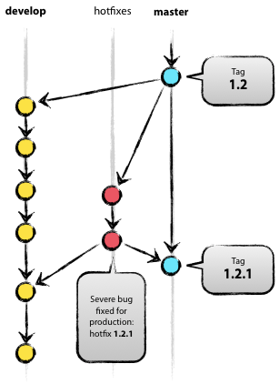
About “hotfix” branches
The Zen of SCM
“Hotfix” branches are used for fixes to production.
Each branch contains a single fix
Must be merged back to both “master” and current “develop” or “release” branches
Source: http://nvie.com/posts/a-successful-git-branching-model/

Slide 29
Summary
Identify benefits of SCM
Apply fork and pull requests
Learn SCM models pros and cons
Monolithic vs Single and Multiple Repos
Identify SCM branch types and how to use them
Apply merging
Notes:
First-Time setup and get to the source
You had your first encounter with the Apigee Plugin by first setting up your environment and cloning the github repo
As we tested there were zero dependencies with private repos
Start with the right API structure
To identify the key elements of the API bundle and where they reside in the folder structure
So, you can follow best practices by defining the API structure from the get go. Since you’re going to use continually use this structure for multiple APIs, eventually you’ll implement more API bundles and troubleshoot them, so it highly recommended to become intimately familiar with it.
Introduced share-pom.xml to provide an example of aggregation in terms configuration, by declaring common configuration in a single place
We also introduced API pom.xml
Apply inheritance
To avoid duplication and better maintainability

Slide 30
The Zen of Build Management

Slide 31
Section objectives
The Zen of Build Management
At the end of this section you will be able to:
Recognize the importance of API build and Deployment tools
Identify the right tool to help you manage the API lifecycle
Practice using Apigee Maven plugin

Slide 32
Let’s start by selecting the right tool
The Zen of Build Management
DevOps Tools
The most common used tools are:
deploy.py
No native Life Cycle
No dependency management
Lower reusability
Harder to transition to “Continuous Integration”
No integration with IDEs
Inconsistent. Every tool in unix has different syntax
Not 100% portable
No community
deploy.py/deploy.sh/
cURL
Easy to learn
Short time to install
Shell based tool
Small foot print
Notes:
Have a quick discussion on other tools…
----- Meeting Notes (6/25/14 20:26) -----
You should be able to improve API lifecycle without increasing complexity
Scripts are great to fullfill one goal. However, when you try to fullfill many goals with the same tools, complexity goes to the roof

Slide 33
The Zen of Build Management
DevOps Tools – deploy.py/deploy.sh
Version 1 (pure bash):
Location and directionshttps://github.com/dzuluaga/apigee-tutorials/tree/master/apiproxies/forecastweather-deploysh
Version 2 (python flavor):
Clone repo https://github.com/apigee/api-platform-samples
Requires Python https://www.python.org/downloads/
Command:
deploy.py -n {apiName} -u {myname:mypass} -o {myorg} -e {environment} -p {basePath} -d {path to /apiproxy directory} –h {base URL}
deploy.py -n forecastweatherapi -u $ae_username:$ae_password -o testmyapi -e test -p weather -d ./temp
Notes:
Have a quick discussion on other tools…
Setup deploy.sh as an alias of environment variables
/Users/ApigeeCorporation/Documents/tools/git/apigee-deploy-maven-plugin-official/apigee-deploy-maven-plugin/samples/forecastweatherapi-recommended/src/gateway/forecastweatherapi
deploy.py -n forecastweatherapi -u $ae_username:$ae_password -o testmyapi -e test -p weather -d ./temp
Use with deploy.sh to avoid passing long parameters

Slide 34


There are two tools that combine the best of both worlds
The Zen of Build Management
DevOps Tools – Apigee Deploy Maven and Grunt.js Plugins
Apigee Deploy Grunt.js Plugin
Apigee Deploy Maven Plugin
Notes:
This is my personal favorite one… since some of the heavy lifting for configuring and testing is done for you…
So, if you liked these tools... so you're gonna love this one

Slide 35
Why choose Apigee Deploy Maven and Grunt.js Plugins tools?
The Zen of Build Management
More time to focus on what really matters by automating repetitive tasks
Innovation ready. Extensible plugin-based platform
Promotes productivity. Promotes usage of CLI (Command-Line Interface). No need for IDEs
Easy to adopt. No need of CLI. Eclipse IDE Support through M2E and IntellijIDEA, WebStorm
Easy to configure and to track changes. All of its artifacts can live in version control as text files
Multilanguage support. One JVM to rule them all (Ruby, Jython, JavaScript, Groovy, Scala) or even Shell scripts
Tens Thousands plugins ready NPM, Maven Central
Backed up by Apigee and the open source community
Notes:
DIEGO
This way the API Team can build more awesome features, faster, better and stronger
This can only be achieved by releasing your developers from repeatable tasks and allowing them to work on tasks that aren't human replaceable

Slide 36



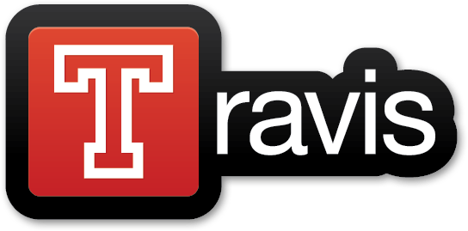

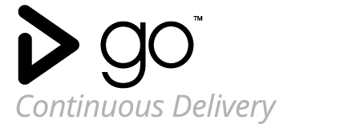
DevOps Tools – Apigee Deploy Maven and Grunt.js Plugins
Ready for CI/CD platforms
Notes:
DIEGO
Ready for CI/CD
It’s tested to run for many customers running the plugin on these CI/CD platforms
It’s not only limited to Jenkins. Any CI platform that can run maven can virtually run the plugin
So, automating the build is a baby step to get to continuous integration and delivery
So, the work that you put upfront getting developers enabled with maven, it’s worth as you will be just one step away from CI. Relate to retail customers running on Maven and the benefits

Slide 37

So what’s the catch?
Summary
Be patient. It takes a few tries to get it right (Maven)
Potential higher learning curve when extending Maven
So far, the benefits outweigh the negatives
And BTW… Since APIs are the building blocks, Everything is programmable!
So, help extending the next killer API Lifecycle Management App! Join the revolution!
Hint: Leverage JavaScript Task Runners. API Proxy Grunt or Gulp
Notes:
So, you might be asking yourself, what’s the catch in here, right?:
you might still be a bit skeptical... And yes there will be challenges ahead for example
But no need to learn Maven from scratch. Apigee has done most of the heavy lifting for you

Slide 38
The Zen of Build Management
Getting Started – Apigee Maven Plugin
Prerequisites to run the plugin
How to install/download Maven plugin artifacts
How to structure your API project
Identify Maven Plugin Components
How to configure and deploy to multiple environments with config.json
How to run the plugin using options
How to run tests as part of the build
Notes:
In this section we’ll getting more technical
How to configure and deploy to multiple environments -> Explain config.json and maven profiles

Slide 39
The Zen of Build Management
Getting Started – Apigee Maven Plugin
Prerequisites to run the plugin
What you will need:
Java(TM) SE Runtime Environment 1.6 or later
Apache Maven 3.0.+ http://maven.apache.org/download.cgi#Maven_3.0.5
Access/Perms to deploy to Apigee Enterprise or On-Premise (4G) environment over HTTP
Latest version of Git
Access to Github
Notes:
VINIT

Slide 40
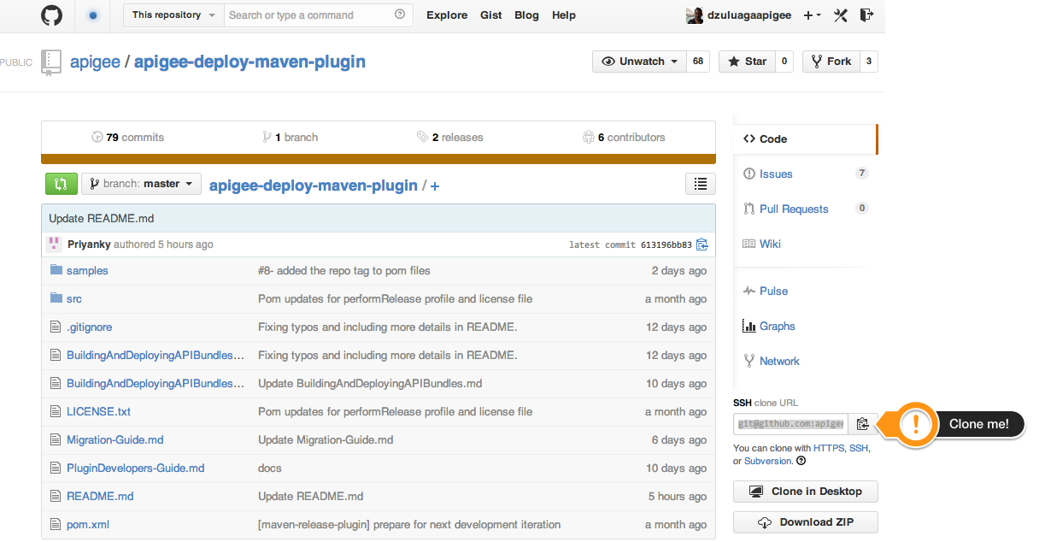
The Zen of Build Management
Getting Started – Apigee Maven Plugin
How to install/download Maven plugin artifacts
Get samples first by cloning this repo https://github.com/apigee/apigee-deploy-maven-plugin
Notes:
VINIT

Slide 41
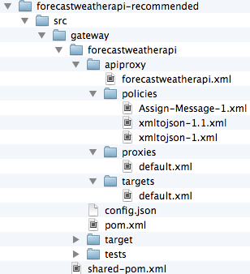
The Zen of Build Management
Getting Started – Apigee Maven Plugin
How to structure your API
Represents All bundles
Contains API bundle with configs and tests
Represents API core bundle
sss
API bundle core
Policy Configurations
API bundle pom.xml
JMeter Tests – JMX and CSV
Shared-pom.xml
Notes:
API Bundle represents the API Proxy to be deployed to the gateway
Examples:
src/gateway/ to contain multiple bundles

Slide 42
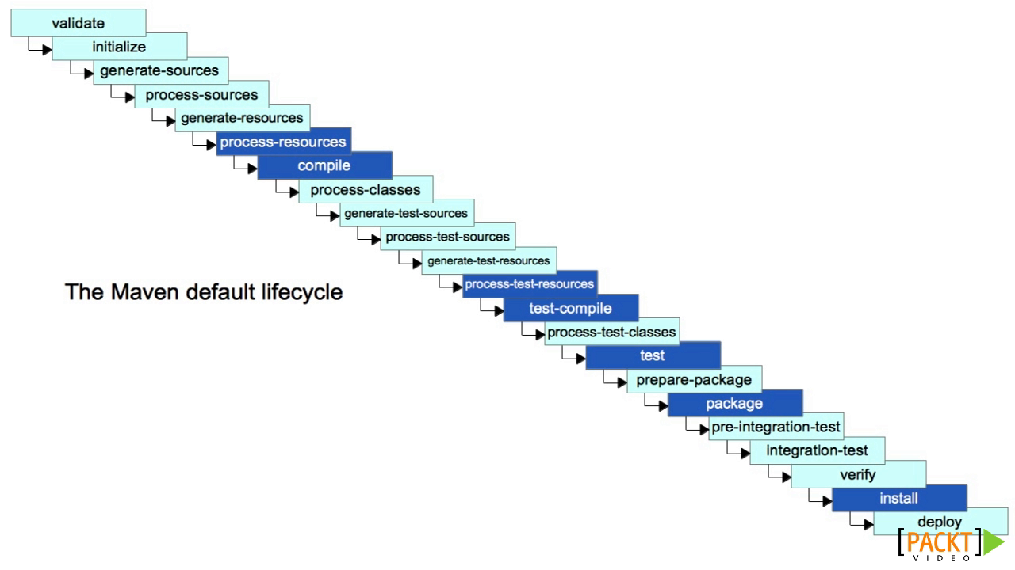
The Zen of Build Management
Getting Started – Apigee Maven Plugin

Slide 43
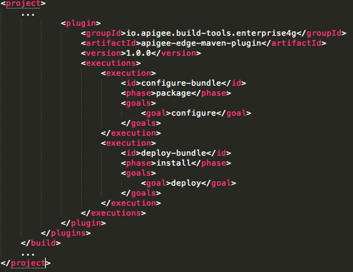
Getting Started – Apigee Maven Plugin
Identify Maven Plugin Components
Shared-pom.xml
Location src/gateway
Contains common dependencies across all bundles
Enables common behavior through inheritance
Plugin coordinates
Phase
Goal
Phase
Goal
Notes:
Location under
Shared-pom.xml or parent pom.xml
Explain how maven downloads plugins from public Maven repositories using plugin coordinates
Maven Central,
GroupId
Based on artifactId
VersionID
No need for private repositories and credentials in settings.xml
Explain inheritance
Benefits
Since common goals are specified at parent pom, there’s no need to specify them again at the pom.xml level – so, you can avoid duplicating plugins across 20 or 40 or whatever number of pom.xmls defined per API
It also allows overriding any configuration if the behavior specified at the parent level does not apply at the child level

Slide 44
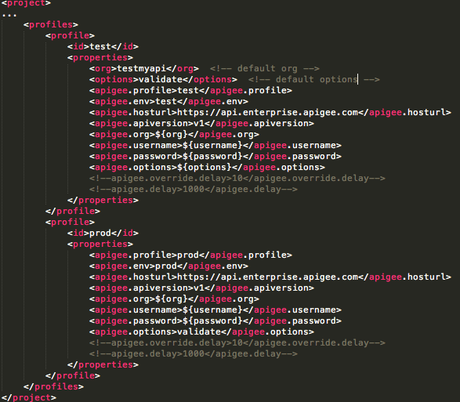
Getting Started – Apigee Maven Plugin
Identify Maven Plugin Components
Cont’d shared-pom.xml
Build Profiles
Key Properties
other profiles
default org
default options
default
hosturl
default
version
default
override
Notes:
Profiles
Profiles are meant to address configuration changes between environments e.g.Test and Prod environments most likely run
Defaul hosturl:
The current value is valid for Apigee Cloud Environment. For on premise environments this value should be modified with your hostname

Slide 45
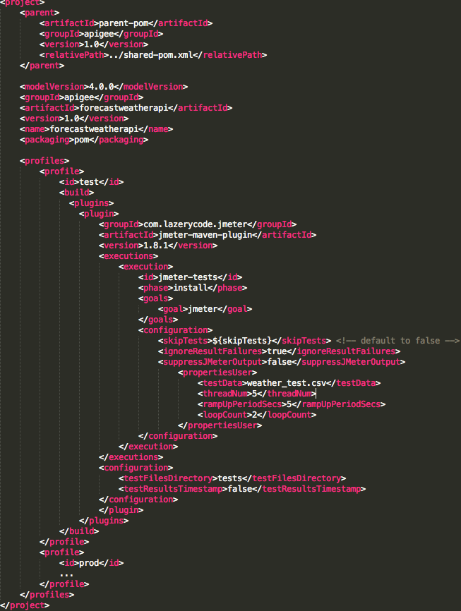
Getting Started – Apigee Maven Plugin
Identify Maven Plugin Components
pom.xml
Parent shared-pom.xml
API Name
profile
JMeter Plugin
default
parameters
Environment-based parameters
other profiles
Notes:
Note reference to shared-pom.xml
API Name is the name which will be created under the Gateway under APIs
Note Profile inheriting from share-pom.xml
Jmeter plugin enables to run Jmeter scripts directly to run directly from the build/deployment script
Note skipTests parameter. This prevent the deployment script to run test
Note environment based parameters. E.g. Sample data for the csv file is specific for DEV environment. Same for the number of threads (threadNum), rampUpPeriodSecs, and loopCount
So, profiles as you can see are very powerful by setting environment specific variables

Slide 46
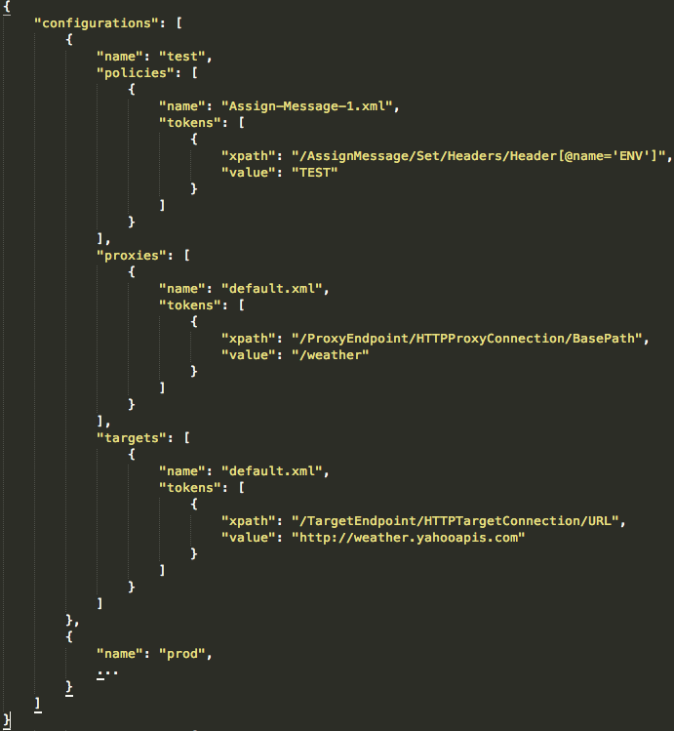
Getting Started – Apigee Maven Plugin
How to configure and deploy to multiple environments with config.json
JSON based
Top must match apigee.env
Policies mapped as arrays
Each policy maps an object
Tokens hold elements to apply configuration
XPath language for search and replace
Support for multiple environments
Notes:
Full support of Xpath see Header[@name=ENV] search expression
Security:
- No keys, no secrets
- Use KVM instead if MD5 verification is required. So the same file signature matches
Do:
- Reassign targets
-

Slide 47
Getting Started – Apigee Maven Plugin: Action
Identify Maven Plugin Components – Maven Commands Example
Default validate (apigee.option) - Create new revision
Clone repo https://github.com/apigee/apigee-deploy-maven-plugin
Just follow steps from TL;DR section
Configure, Package, Import, Deploy, Test
mvn install -Ptest -Dusername=$ae_username -Dpassword=$ae_password -Dorg=testmyapi
Test: https://testmyapi-test.apigee.net/weather/forecastrss\?w\=2502265
Notes:
Demo with no skipTests arguments
Notice passing username and password as environment variables. You don’t want to expose your credentials storing them in you source control repository
Notice I passed –Dorg=testmyapi, in case you want to target an organization different than the default one specified in pom.xml
Config.json to be explained in the next steps
Tests with Jmeter to be explained in the next steps

Slide 48
Getting Started – Apigee Maven Plugin
Identify Maven Plugin Components – Maven Commands Example
Other useful commands:
Skips tests -DskipTests=true
Overrides current revision -Doptions=validate,update
Deletes currently deployed bundle -Doptions=clean
Imports without deploying -Doptions=inactive
Packages bundle
mvn package -Ptest
Runs JMeter Tests
mvn jmeter:jmeter -Ptest -Dusername=$ae_username -Dpassword=$ae_password -Dorg=testmyapi -DtestData=weather_test.csv -DthreadNum=5 -DrampUpPeriodSecs=5 -DloopCount=2
Notes:
Demo with no skipTests arguments
Notice passing username and password as environment variables. You don’t want to expose your credentials storing them in you source control repository
Notice I passed –Dorg=testmyapi, in case you want to target an organization different than the default one specified in pom.xml
Config.json to be explained in the next steps
Tests with Jmeter to be explained in the next steps

Slide 49

Grunt API Lifecycle Management Plugin
Easy and flexible
It’s JavaScript! Node! NPM!
Plays well with TDD frameworks
Empowers the developer to apply continuous improvement to the lifecycle
Notes:
Demo with no skipTests arguments
Notice passing username and password as environment variables. You don’t want to expose your credentials storing them in you source control repository
Notice I passed –Dorg=testmyapi, in case you want to target an organization different than the default one specified in pom.xml
Config.json to be explained in the next steps
Tests with Jmeter to be explained in the next steps

Slide 50
Grunt API Lifecycle Management Plugin: Action
Clone repo from here https://github.com/apigeecs/apigee-deploy-grunt-plugin
Follow steps from Github
Notes:
If you notice, we’re using the same command that was used prior when running maven install for deployment. Except that we’re enabling a new plugin in the process to resolve fragments into actual code

Slide 51
Summary
Identify different tools for managing the lifecycle
Recognize the benefits of Maven Plugin
How to get started with Maven Plugin
Configure the API bundle for multiple environments with config.json
Recognize the benefits of Grunt.js Plugin
Notes:
First-Time setup and get to the source
You had your first encounter with the Apigee Plugin by first setting up your environment and cloning the github repo
As we tested there were zero dependencies with private repos
Start with the right API structure
To identify the key elements of the API bundle and where they reside in the folder structure
So, you can follow best practices by defining the API structure from the get go. Since you’re going to use continually use this structure for multiple APIs, eventually you’ll implement more API bundles and troubleshoot them, so it highly recommended to become intimately familiar with it.
Introduced share-pom.xml to provide an example of aggregation in terms configuration, by declaring common configuration in a single place
We also introduced API pom.xml
Apply inheritance
To avoid duplication and better maintainability

Slide 52
Keep the momentum up - Build Complementary Tools
Notes:
DIEGO –
So, before diving deeper into technical aspects, let’s talk a little bit about the current state of the build and deployment process

Slide 53
Section objectives
At the end of this section you will be able to:
Recognize the importance of code reusability
Practice using Proxy Maven Dependency Plugin
Identify the key elements of Functional/Blackbox Testing

Slide 54
Complementary Tools
Proxy Dependency Maven Plugin – Why DRY?
The challenge: Uncontrolled duplication of code becomes a maintenance nightmare
Meant to prevent code duplication or DRY (Don’t Repeat Yourself)
Get it here: https://github.com/apigee/proxy-dependency-maven-plugin
Notes:
The next plugin that we’re going talk about is the Proxy Dependency Maven Plugin:
it’s common and a good practice that code gets reused by multiple api bundles
In fact, the last thing you want to happen is that members of your team write code that someone else already did
However, the problem with code duplication becomes more obvious when the code is replicated once, twice, thrice and so on
Until someone realizes that the code replicated x number of times contained a bug, the 20 copies of the original solutions are also now broken
Enter Proxy Dependency Maven Plugin
In fact, between 60 to 80% of the code/logic of any given customer
Code duplication can lead to maintenance hell

Slide 55
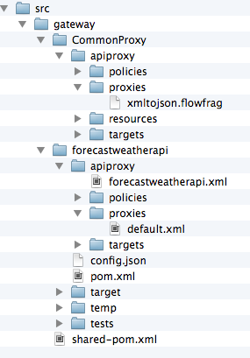
Complementary Tools
Proxy Dependency Maven Plugin
Basic Concepts:
Common Fragments shared across multiple API Bundles
Common proxy
Proxy fragment
API Bundle
Reference to fragments

Slide 56
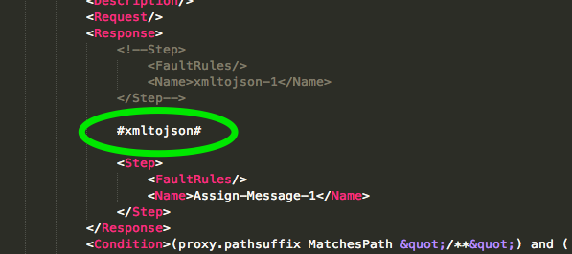
Complementary Tools
Proxy Dependency Maven Plugin
Fragment reference from proxies/default.xml

Slide 57
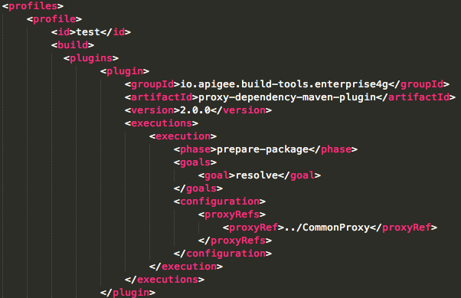
Complementary Tools
Proxy Dependency Maven Plugin
How to use this dependency from pom.xml
Plugin coordinates
Prepare phase
Goal
Reference to CommonProxy
Notes:
Between 60 to 80% of the code/logic of any given customer
Code duplication can lead to maintenance hell

Slide 58
Getting Started – Apigee Maven Plugin: Action
Proxy Dependency Maven Plugin – Maven Commands Example
Clone repo https://github.com/apigee/proxy-dependency-maven-plugin
mvn install -Ptest -Dusername=$ae_username -Dpassword=$ae_password -Dorg=testmyapi
Test: https://testmyapi-test.apigee.net/weather/forecastrss?w=2502265
Notes:
If you notice, we’re using the same command that was used prior when running maven install for deployment. Except that we’re enabling a new plugin in the process to resolve fragments into actual code

Slide 59
Complementary Tools
Functional Testing
Also called blackbox testing
Examines the functionality of an API typically at a higher level
Promotes write tests before writing code TDD (Test Driven Development)
Promotes speed by multithreading TDD with Mock services
Input
Request
Verbs
Parameters
Headers
Body/Content
Northbound
API
SPEC
Middle Layer
Output
Response
Headers
Response Codes
Body/Content
Southbound
Notes:
Explain a little bit about Functional Testing from a Developer’s perspective
Because it is useful to understand how QA Teams will usually test APIs that I built as developer
So, from developer standpoint, one of the most important aspects/if not the most important is to interact effectively with these teams
It examines the functionality of an API
without peering into its internal structures or working
Doesn’t require specific knowledge of the application's code/internal structure
Test cases are built around specifications and requirements, i.e., what the API is supposed to do. Test cases are generally derived from external descriptions of the software, including specifications, requirements and design parameters
Essentially
Low Maintenance Test:
you don’t have to rewrite the whole test suite when refactoring the deep internals of your app
It tests what really matters an API
Actually has a meaning to the business
It’s a test that business, QA Testers and developers can understand
Can be expanded to even

Slide 60
Complementary Tools
Functional Testing - JMeter
Get examples https://github.com/apigee/apigee-deploy-maven-plugin
Use assertions to
Validate response codes
Validate payload content
Validate schemas (JSON – DRAFT04)
Validate response times. Spot network latency and performance issues

Slide 61
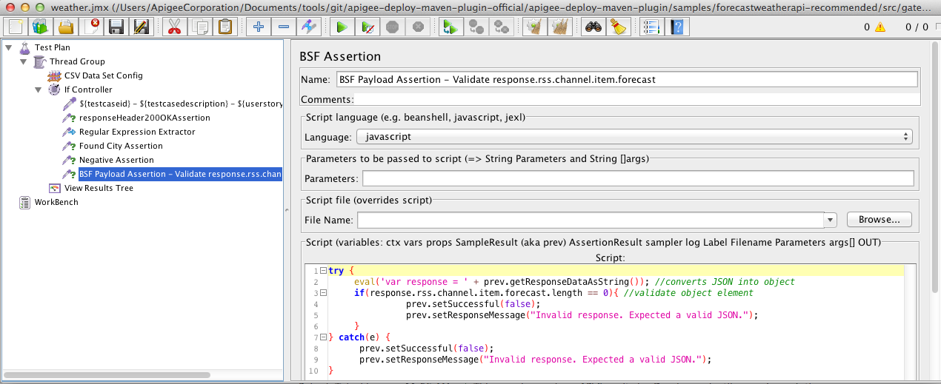
Complementary Tools
Functional Testing - JMeter
Load CSV
Validate response code
RegEx extract data
Validate payload content
Negative assertions
Look ma’ JavaScript!

Slide 62



Complementary Tools
Functional Testing with Node.js – Mocha, Chai and Jasmine
Simple, flexible and fun
More lightweight
Just edit and rerun. It’s just script
More oriented towards TDD and BDD (Behavior Driven Development)
Get examples https://github.com/apigeecs/apigee-deploy-grunt-plugin
Cons
Requires JavasScript skillset from QA
Notes:
So, what’s in it for me?
These tools are improving the experience of the overall lifecycle by providing simpler frameworks
Which means that as developer you’ll get faster feedback before code gets too big and becomes a monster to maintain
These frameworks are shaping the industry
Why aren’t these tools in use in some teams?
The plain reality is that in most organizations testers in QA teams aren’t at this level, and we need to get them to get at this level by showing them the way

Slide 63
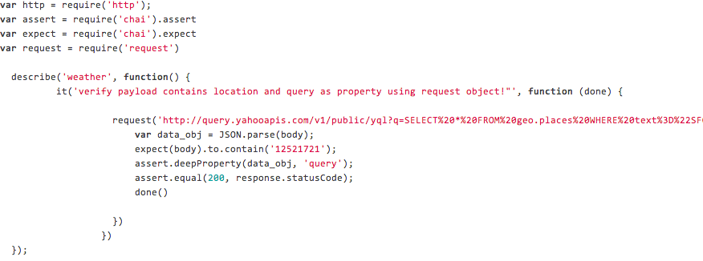
Complementary Tools
Functional Testing with Node.js – Mocha, Chai and Jasmine
Send a request
Assert payload content
Assert status codes
Assert payload elements
Notes:
So, what’s in it for me?
These tools are improving the experience of the overall lifecycle by providing simpler frameworks
Which means that as developer you’ll get faster feedback before code gets too big and becomes a monster to maintain
Why aren’t these tools in use in some teams?
The plain reality is that in most organizations testers in QA teams aren’t at this level, and we need to get them to get at this level by showing them the way

Slide 64
Complementary Tools
Best practices
Avoid
Hardcoding values. Parameterize scripts via CSV files
Checking in sensitive data to SCM
Thumbs up
Apply TDD – write tests first, code against them
The goal is to automate testing!
Check for latency issues
Ensure Test script can be executed by CI
Extend JMeter capabilities with JMeter Plugins (JSON Path, Spike Arrest) http://jmeter-plugins.org/
Ensure tests are repeatable, so tear up and down scripts

Slide 65
Summary
Learn principles and tools to apply code reusability
Learn the benefits of functional testing
Overview of the tools used for functional testing
JMeter, Mocha.js, Jasmine, Chai
Notes:
First-Time setup and get to the source
You had your first encounter with the Apigee Plugin by first setting up your environment and cloning the github repo
As we tested there were zero dependencies with private repos
Start with the right API structure
To identify the key elements of the API bundle and where they reside in the folder structure
So, you can follow best practices by defining the API structure from the get go. Since you’re going to use continually use this structure for multiple APIs, eventually you’ll implement more API bundles and troubleshoot them, so it highly recommended to become intimately familiar with it.
Introduced share-pom.xml to provide an example of aggregation in terms configuration, by declaring common configuration in a single place
We also introduced API pom.xml
Apply inheritance
To avoid duplication and better maintainability

Slide 66
Make it eternal, take it to the next level
Notes:
DIEGO –

Slide 67
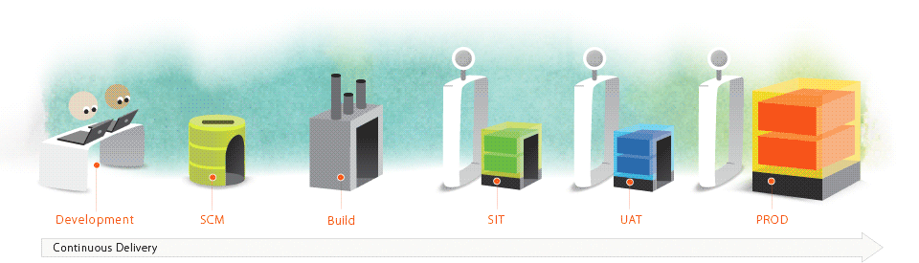
Take it to the next level – Apigee CI/CD
What is CI/CD and what are its principles?
Continuous integration (CI) is the practice, in software engineering, of merging all developer working copies with a shared mainline several times a day
It was first named and proposed as part of extreme programming (XP)
Its main aim is to prevent integration problems, referred to as "integration hell”

Slide 68
Take it to the next level – Apigee CI
Principles
Maintain a code repository
Automate the build
Make the build self-testing
Keep the build fast
Make it easy to get the latest deliverables
Everyone can see the results of the latest build
Automate deployment

Slide 69

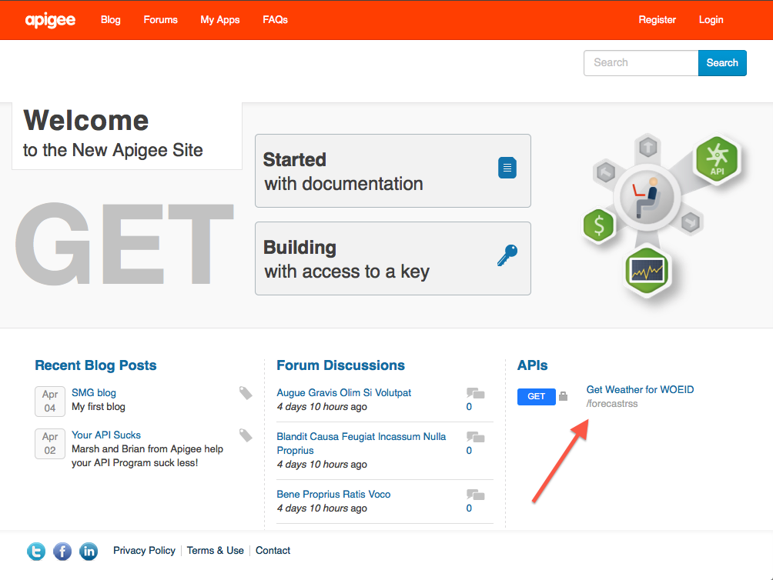


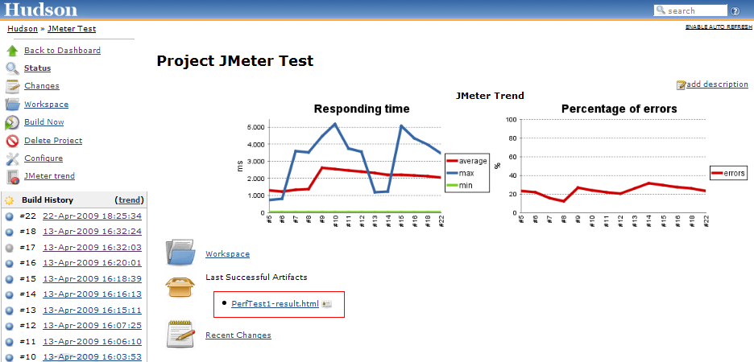






Take it to the next level – Apigee CI
Dev Team
Source Code
Version Control
API Job is triggered
Static Code Analysis
Code coverage analysis
Deploy API Bundle
Pull Request or Merge
Run Unit, Functional, and Performance Tests
Publish Reports
Update Docs
Continuous Integration

Slide 70
Getting started…
Clone repo https://github.com/dzuluagaapigee/apigee-ci-jenkins-git-maven-jmeter
Multiple ways to run Jenkins:
Create account in Cloudbees
Apigee instance http://10.10.3.75:8080/ (Apigee VPN required)
start a Vagrant Box (locate file Vagrant file under repo tools/Vagrant folder)
Run “vagrant up” (it will install JDK, Jenkins and open up ports)
Point browser to http://127.0.0.1:8088
Follow directions from README.md
Install Jenkins plugins
Import forecastweatherapi Jenkins with Jenkins-cli
Setup SSH keys in Jenkins (optional)
Add Jenkins SSH key in Github (optional)
Setup Github pull request builder configuration (optional)
Good reads… The Phoenix Project by Gene Kim, Continuous Delivery by Jez Humble

Slide 71
Summary
Learn principles and benefits of continuous integration/delivery
Install Jenkins
Vagrant
Plugins
Install the API Lifecycle DevOps tools in Jenkins
Connect to a Git Repo
Leverage
Apigee Deploy Maven Plugin
Grunt
Notes:
First-Time setup and get to the source
You had your first encounter with the Apigee Plugin by first setting up your environment and cloning the github repo
As we tested there were zero dependencies with private repos
Start with the right API structure
To identify the key elements of the API bundle and where they reside in the folder structure
So, you can follow best practices by defining the API structure from the get go. Since you’re going to use continually use this structure for multiple APIs, eventually you’ll implement more API bundles and troubleshoot them, so it highly recommended to become intimately familiar with it.
Introduced share-pom.xml to provide an example of aggregation in terms configuration, by declaring common configuration in a single place
We also introduced API pom.xml
Apply inheritance
To avoid duplication and better maintainability

Slide 72
Make it stick
Notes:
DIEGO –

Slide 73
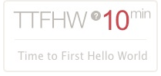
Strategies to decrease TTFHW
Make it stick
Explore Interactive Documentation
Simplify Code with Client Libraries
Dog food your APIs!
If it’s difficult to me, it’s 10x more difficult to others
Reproduce Complete Sample Apps
Listen and keep up with your users
Apply UX techniques – Lean UX
Increase community engagement – StackOverflow, Dev Channel Blog

Slide 74
Manage API documentation
Make it stick
Treat documentation as code. Keep it in version control
Don’t write HTML by hand
Use API Lifecycle tool to publish
Test documentation. It also has a lifecycle
Apply continuous improvement
Make it part of CI/CD

Slide 75
Key features
Make it stick - SmartDocs
Method-level docs
Rich detail
Internal and external SEO benefits
Interactive
Make requests without leaving the page
A tool that learns
Remembers developers’ preferred values and credentials
Completely customizable
Handlebars-driven templates
Complete control over layout, interactions, and look and feel
Edit what you see
Model semantics preserved in the generated HTML
WYSIWYG
Separation of roles (writer vs engineer)

Slide 76
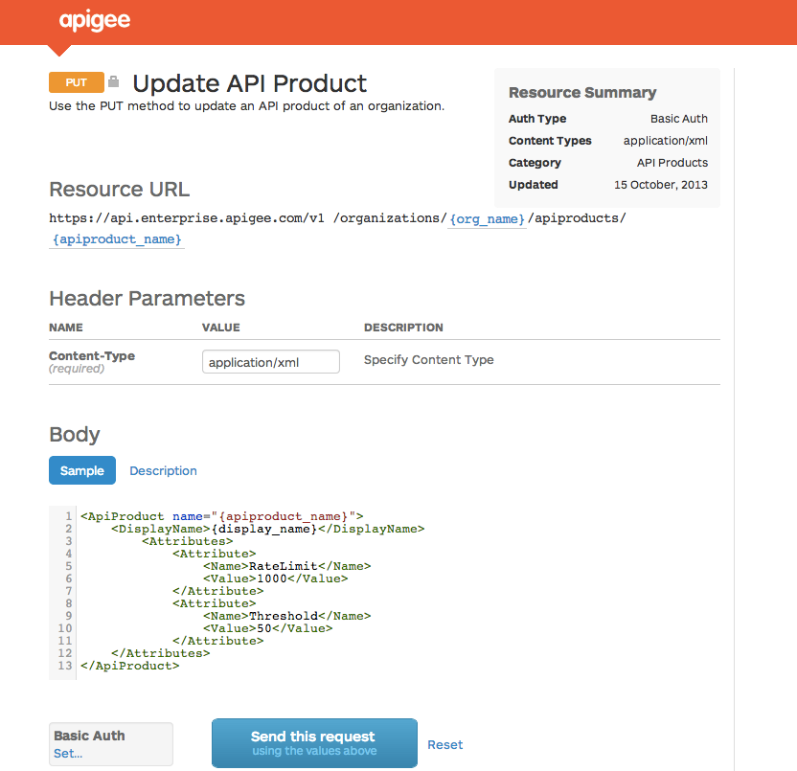



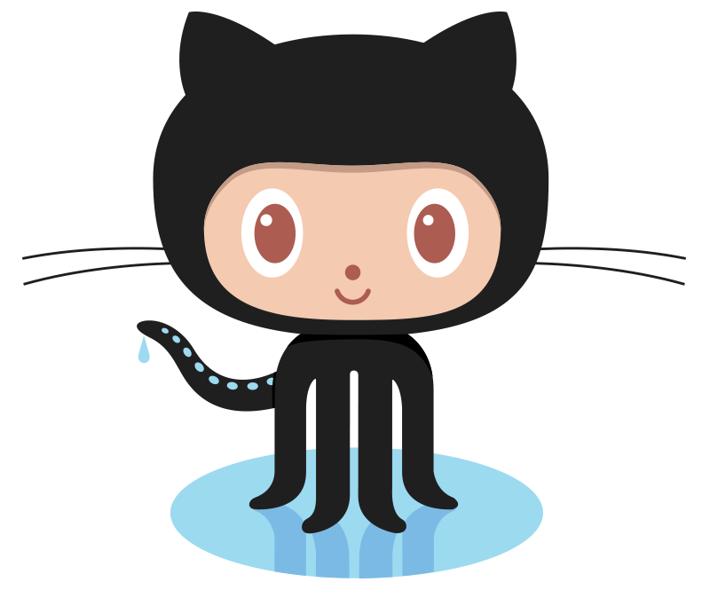
Implement progressive API Modeling and SmartDocs
Make it stick - SmartDocs
API Modeling
Describe an API structure
SmartDocs
Generate interactive documentation
API-based
Integrate with any portal / CMS
Apigee Edge Developer Services
Other CMS
gh-pages
Notes:
Main Points:
Edge Developer Services offers great modeling and documentation of API models functionality
Script:
API Modeling is a central service that holds the machine-structure of your API, and it uses that structure to organize all related metadata for your API.
The Smart doc generator takes that model and renders it into detailed API docs that developers need to be successful. Edge API Modeling and Smart docs are progressive – meaning that there is two way interaction between the model and the Smart doc and the API model continues to learn from updates made directly in the Smart doc too.

Slide 77
Make it stick - SmartDocs
WADL or Swagger?
WADL is XML-based
Swagger is JSON and YAML
Look for an industry standard
Swagger Spec - https://github.com/wordnik/swagger-spec/

Slide 78
Make it stick – SmartDocs: Action
Run steps from sample-api-smartdocs
https://github.com/dzuluaga/apigee-tutorials/tree/master/apiproxies/sample-api-smartdocs
Notes:
If you notice, we’re using the same command that was used prior when running maven install for deployment. Except that we’re enabling a new plugin in the process to resolve fragments into actual code

Slide 79
Make it stick – APIBlueprint.org
Key Features
Based on Pure Markdown
Easy Lifecycle
CLI tools
Integration with API Mock services
Tooling - http://apiblueprint.org
Apiary.io | http://apiary.io | API Mock service
Aglio | https://github.com/danielgtaylor/aglio | Documentation generation
Dredd | https://github.com/apiaryio/dredd | Test Documentation
cURL Trace Parser | https://github.com/apiaryio/curl-trace-parser | Record HTTP communication directly in Blueprint format
Sublime Text Plugin | https://github.com/apiaryio/api-blueprint-sublime-plugin | API blueprint syntax highlighting
API Blueprint Mock Server | https://bitbucket.org/outofcoffee/api-blueprint-mockserver | Mock server in Java for in-house deployment

Slide 80
Make it stick – APIBlueprint.org
Publish HTML output to
Github Pages
Dev Channel
Requires Git access to Pantheon

Slide 81
August 2014

